Slide 1
PROJECT TITLE
CAPSTONE PROJECT
Presented By: Anumanthu Ramya Sri
Student Name : A Ramya Sri
College Name & Department : SIET & CSE(AIML)

Slide 2
OUTLINE
Problem Statement
Technology used
Wow factor
End users
Result
Conclusion
Git-hub Link
Future scope

Slide 3
Problem Statement
With the increasing need for secure communication, sensitive information is at risk of unauthorized access. Traditional encryption methods can attract attention, making them vulnerable to attacks. Steganography offers a solution by hiding data within images, ensuring covert transmission of confidential messages. This project focuses on developing a secure image steganography system to embed and extract secret messages while maintaining image integrity.

Slide 4
Technology used
Python – Core programming language for implementation.
OpenCV – Image processing and manipulation for embedding/extracting data.
Tkinter – GUI development for user-friendly interaction.
Steganography Algorithm – Pixel-based encoding and decoding of hidden
messages.
File Handling – Managing encrypted and decrypted images securely.
,

Slide 5
Wow factors
Seamless Integration – Provides a user-friendly GUI with Tkinter for easy encryption and decryption
of messages in images.
Stealthy Communication – Hides messages inside images without altering their visible appearance,
making it nearly impossible for unauthorized users to detect.
Password Protection – Ensures added security by requiring a correct passcode for decryption,
preventing unauthorized access.
Efficient and Lightweight – Uses OpenCV for fast image processing without significant loss of quality.
Cross-Platform Compatibility – Works on Windows, Linux, and macOS, making it accessible
for various users.

Slide 6
End users
Government & Defense Agencies – For secure communication and confidential data exchange
without attracting attention.
Journalists & Whistleblowers – To safely share sensitive information without the
risk of detection.
Corporate Organizations – To protect trade secrets, confidential reports, and
intellectual property.
Cybersecurity Professionals – For testing and implementing secure data-hiding techniques.
Students & Researchers – To explore steganography for academic projects and
encryption-related studies.

Slide 7

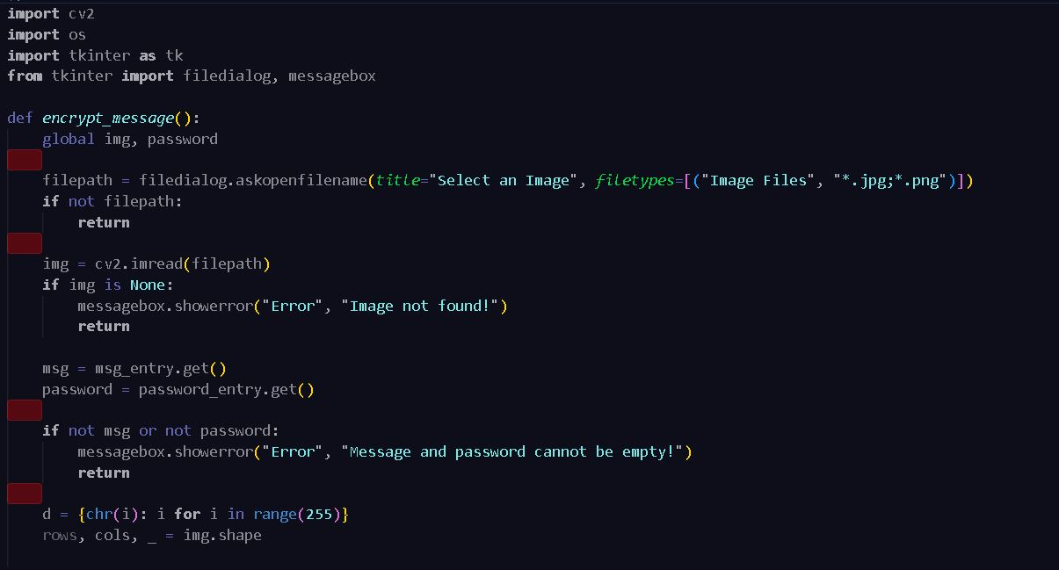
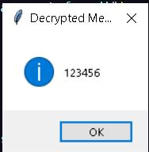
Results
Encrypted image
code

Slide 8
Conclusion
This project successfully implements image steganography using Python, OpenCV, and Tkinter, allowing secure data hiding within images. The system provides a user-friendly interface for encrypting and decrypting messages while ensuring confidentiality through password protection. By leveraging steganography, the project enables covert communication, making it ideal for secure information exchange. With its efficient, lightweight, and scalable design, this solution can be further enhanced for real-world applications in cybersecurity, digital forensics, and secure messaging systems.

Slide 9
GitHub Link
https://github.com/RamyaSriAnumanthu/Stegnography.git

Slide 10
THANK YOU

